Slide 1
Machine Learning A-Z™: Hands-On Python & R In Data Science
Decision Trees and Random Forests
June 21, 2019
Ariel Capetillo
Juan Carlos Urrutia

Slide 2
Contents
01 |  | Introduction to Decision Trees (DT)
02 |  | DT in Python
03 |  | DT in R
04 |  | DT Quiz
05 |  | Introduction to Random Forests
06 |  | RF in Python
07 |  | RF in R
08 |  | RF Quiz
09 |  | Model Selection
Notes:
Ask: Who watched this week videos?

Slide 3
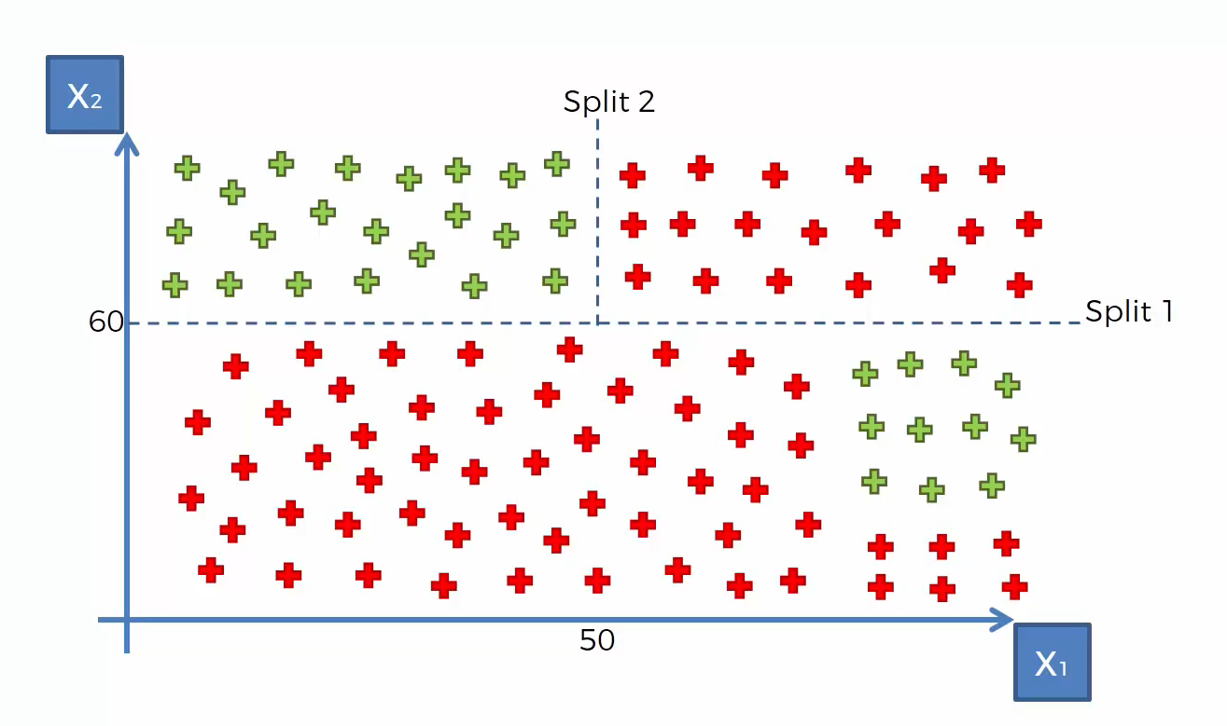
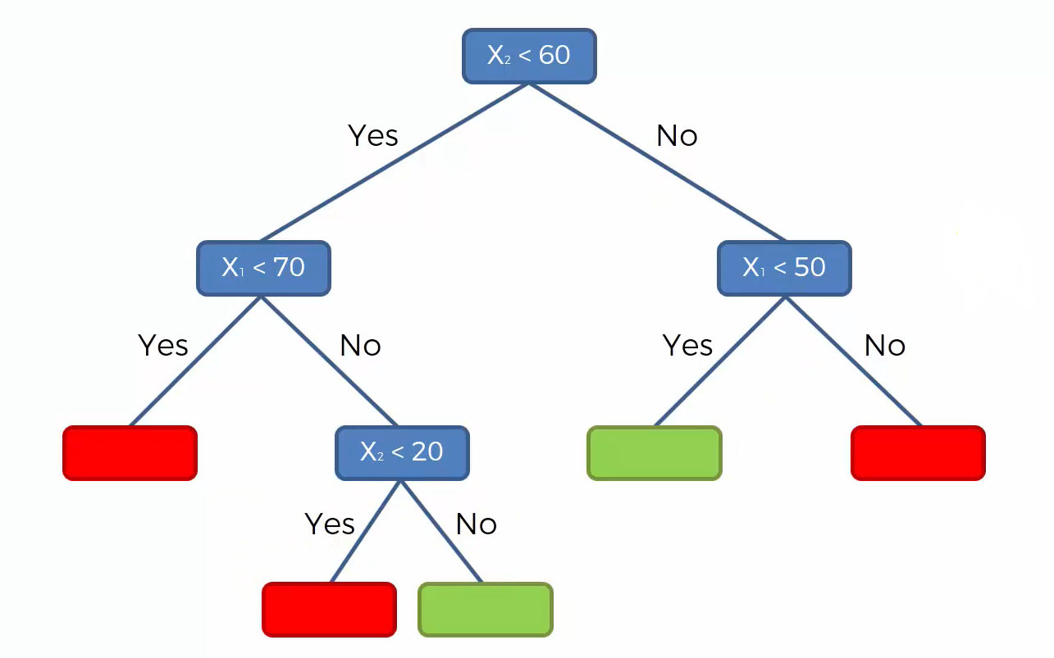
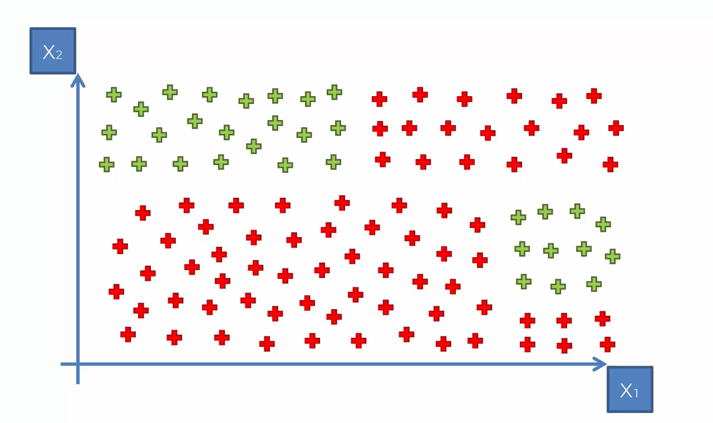
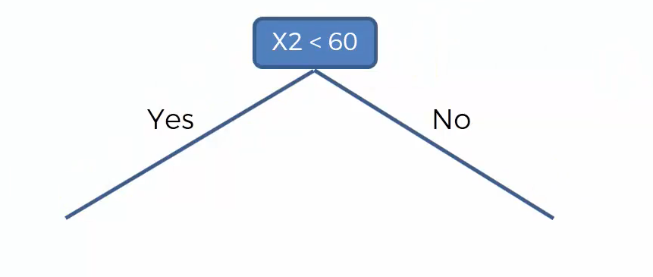
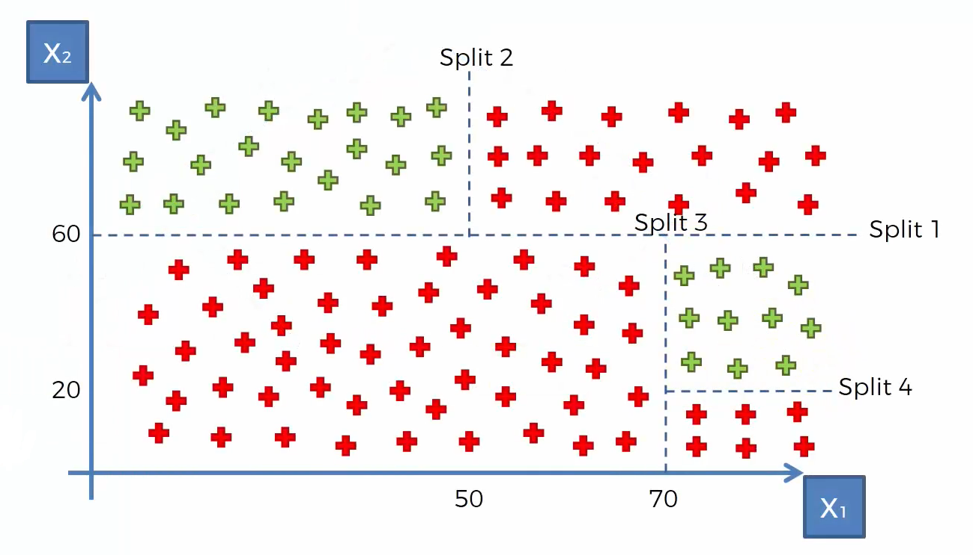
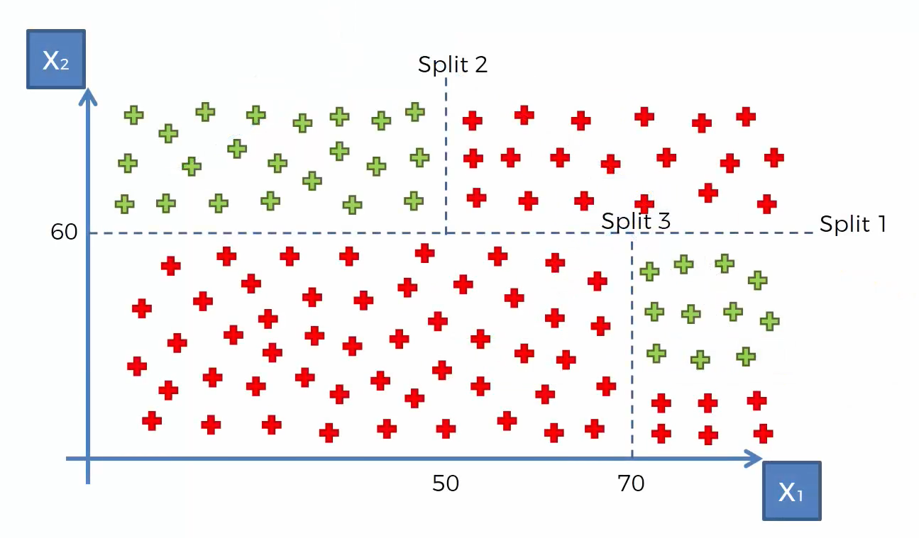
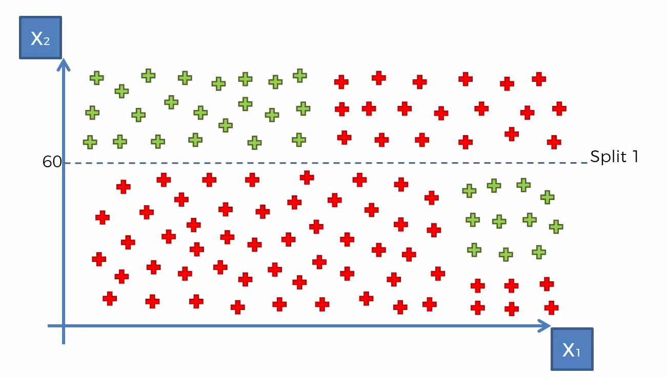
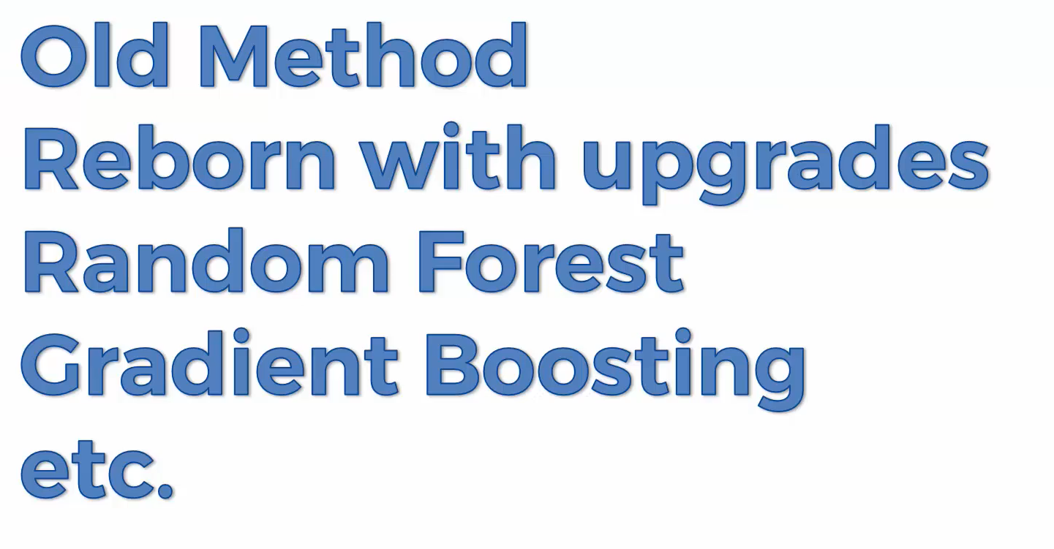
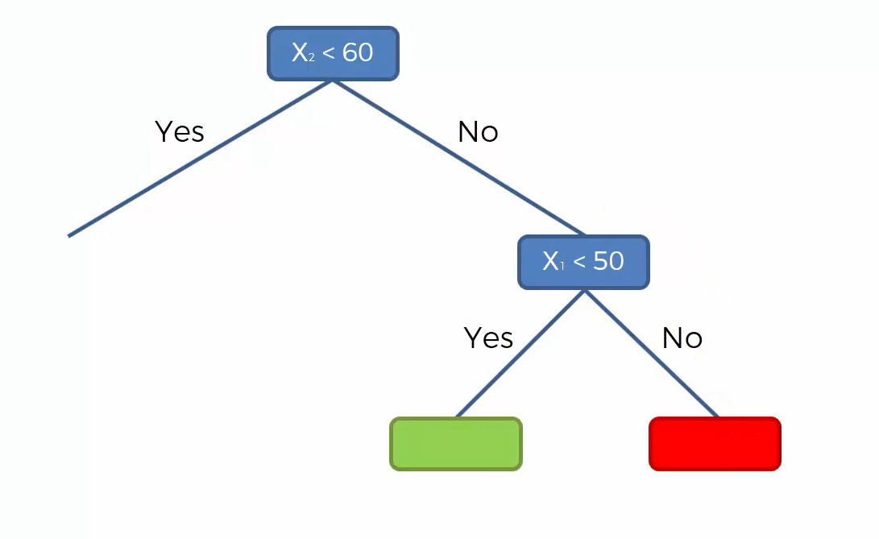
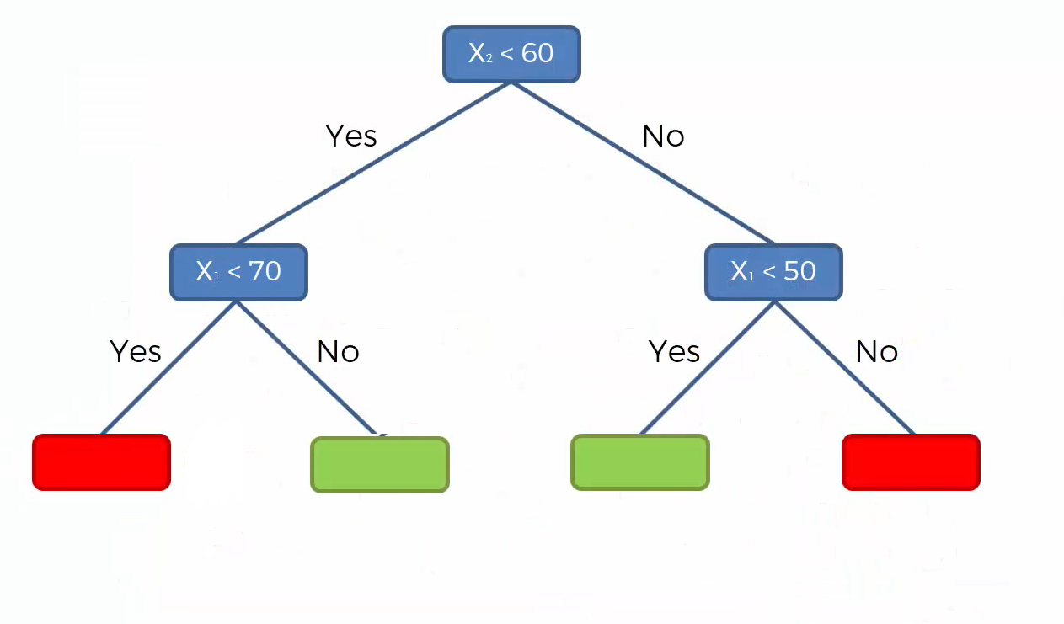
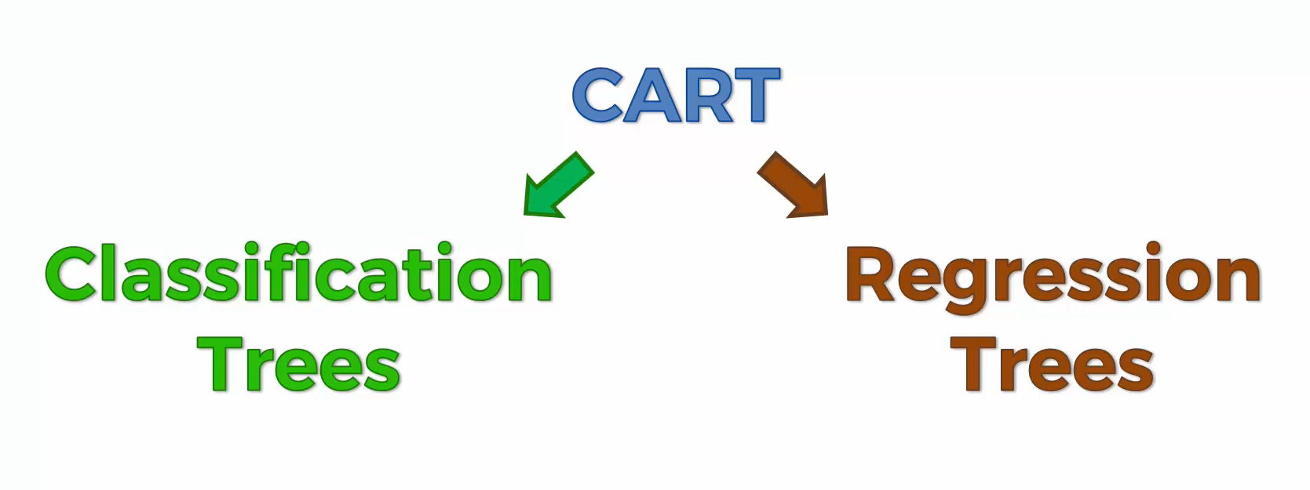
Decision Trees
The splits pretend to minimize entropy. What does that mean?
Often interpreted as the degree of disorder or randomness in the system.

Slide 4
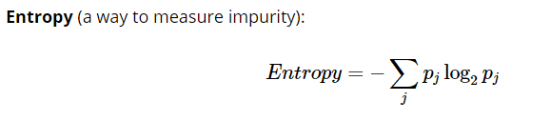
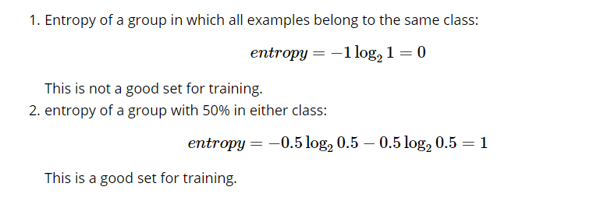
Useful Concepts for DT (and RF)
So, basically, entropy attempts to maximize the mutuial information (by constructing a equal probability node) in the decision tree

Slide 5
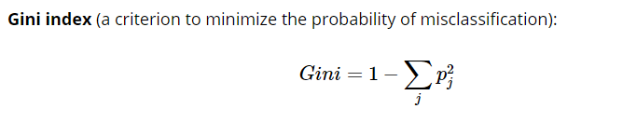
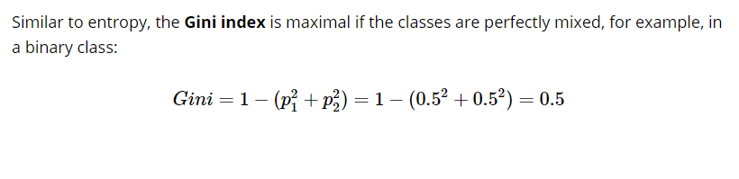
Useful Concepts for DT (and RF)

Slide 6
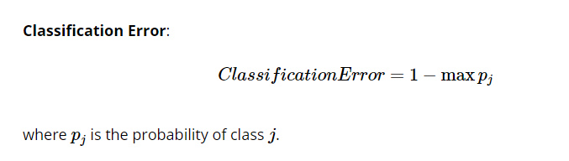
Useful Concepts for DT (and RF)

Slide 7
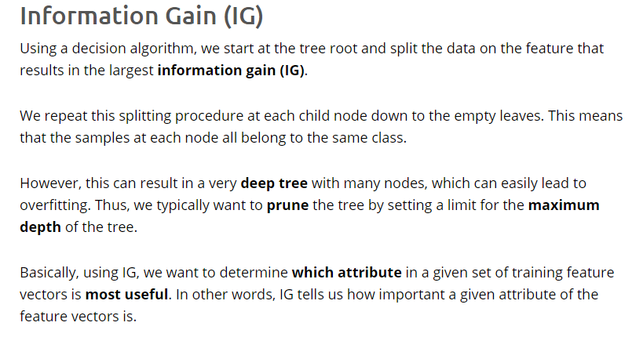
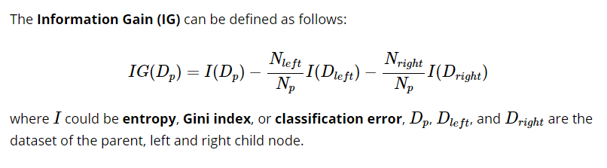
Useful Concepts for DT (and RF)

Slide 8
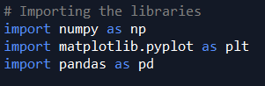
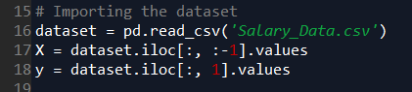
Decision Trees in Python
Python libraries for pre-processing:
Numpy: Mathematics library. Useful for making calculations.
Pyplot: Sub-library of matplotlib. Useful for plotting nice charts in Python
Pandas: Most famous library for importing and managing datasets.
1
2
We import the csv file. Then, we standardize it at our convenience (in this case, as arrays for the dependent and independent variables).
”pd” is the pandas library
iloc is used for specifying an index

Slide 9
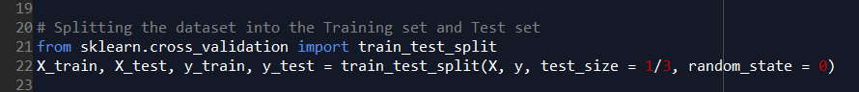
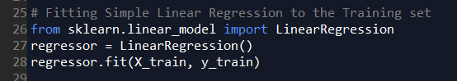
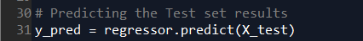
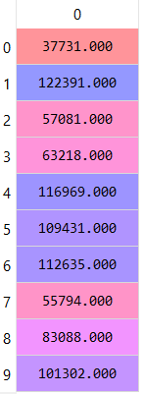
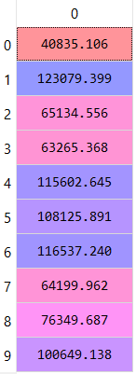
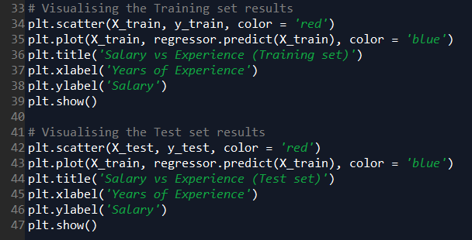
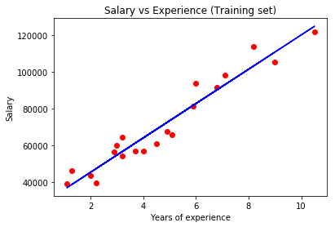
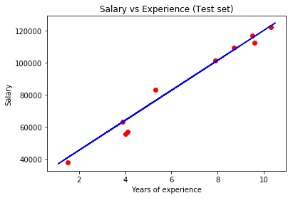
Decision Trees in Python
3
4
Let’s talk a little bit about the parameters:
-fit_intercept: When shall we use it?
-normalize: What does this mean?
-n_jobs: This could optimize the process. Why?
5
y
y'
6

Slide 10
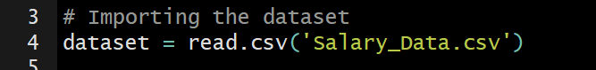
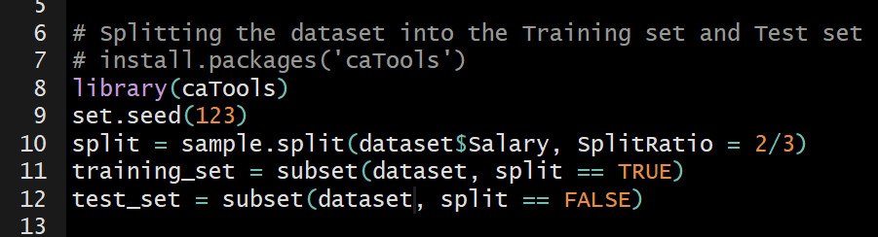
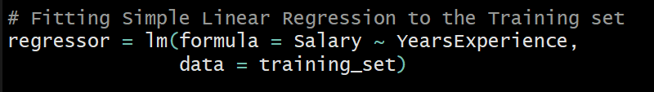
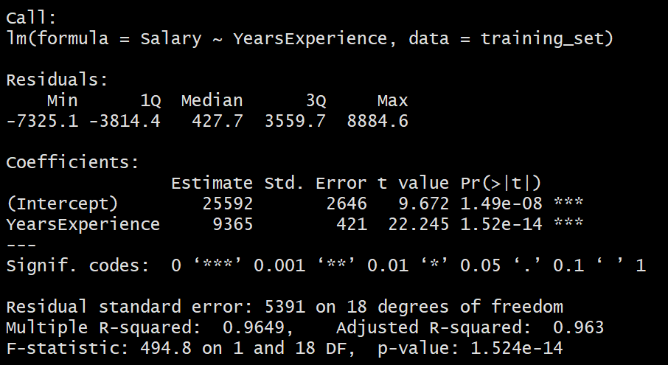
Decision Trees in R
1
Which is the library we need for read.csv?
2
Remember, the library caTools is required for splitting the dataset
3
Let’s talk about:
-Residuals -Coefficients
-Estimates -Std. Error
-t value -Significance codes
-Degrees of freedom -R-squared
-Adjusted R-Squared -F-statistic
-p-value*

Slide 11
Decision Trees Quiz

Slide 12

Random Forest
1
Pick at random K data points from the training set
Random Forests, in average, can perform very well, leveraging the power of the crowd
2
Build the decision tree associated to these K data points
3
Choose the number of trees that you want to build and repeat steps 1 and 2.
4
For a new data point, make every tree predict the category to which the data point belongs, and assign the new data point to the category that wins the majority vote

Slide 13
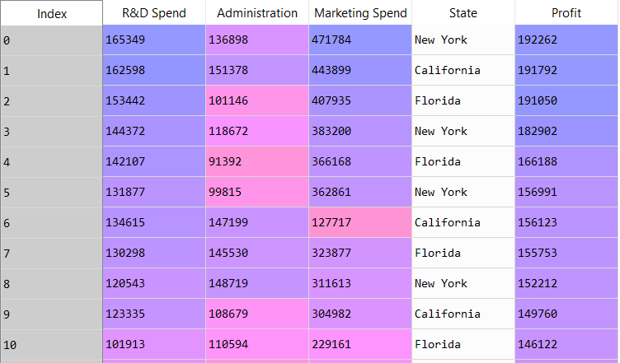
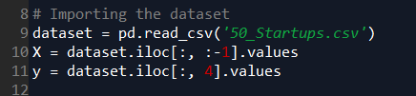
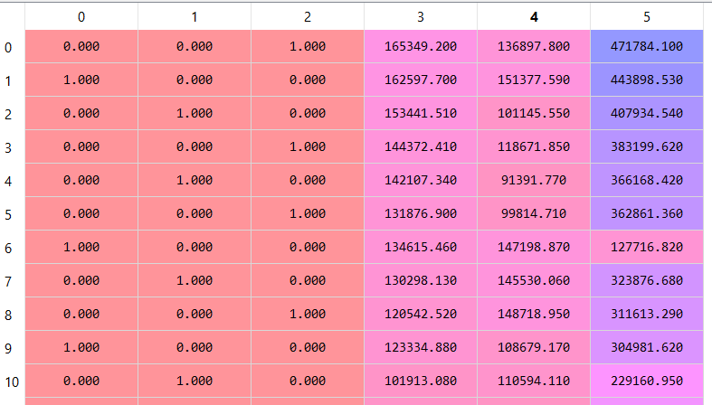
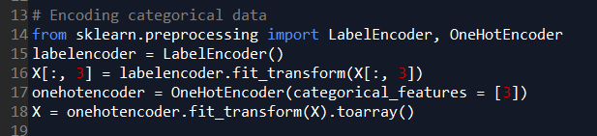
Random Forest in Python
1
2
3

Slide 14
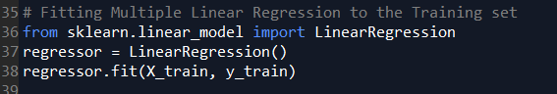
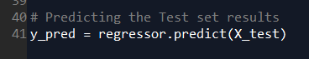
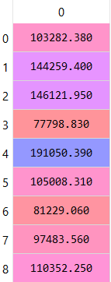
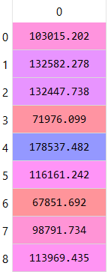
Random Forest in Python
4
Do you see any similarity with SLR?
Why don’t we use the feature selection code?
5
6
y
y’
Why they don’t use a visualization to compare y_test (y) with y_pred (y’)?

Slide 15
Random Forests Quiz

Slide 16
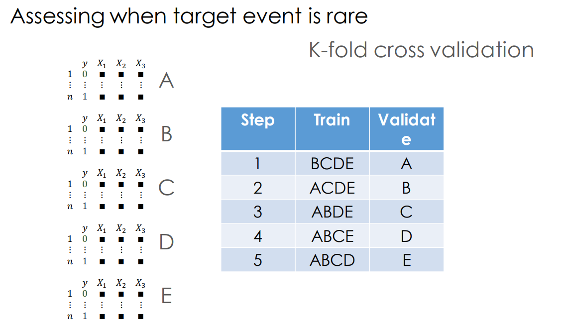
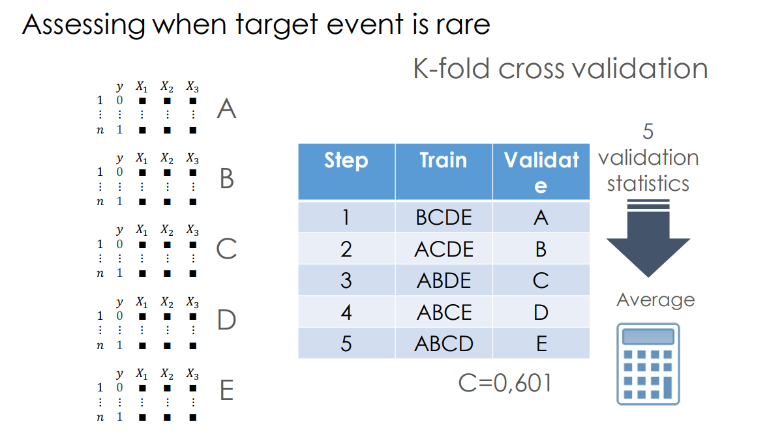
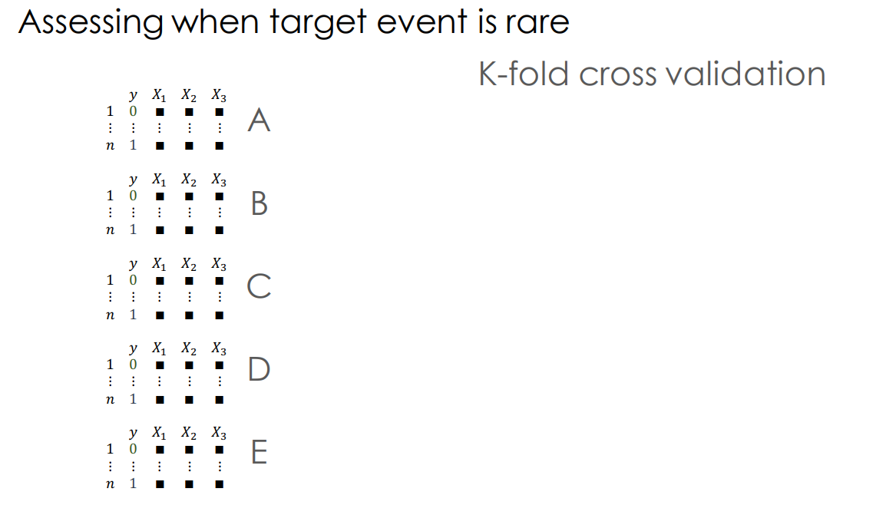
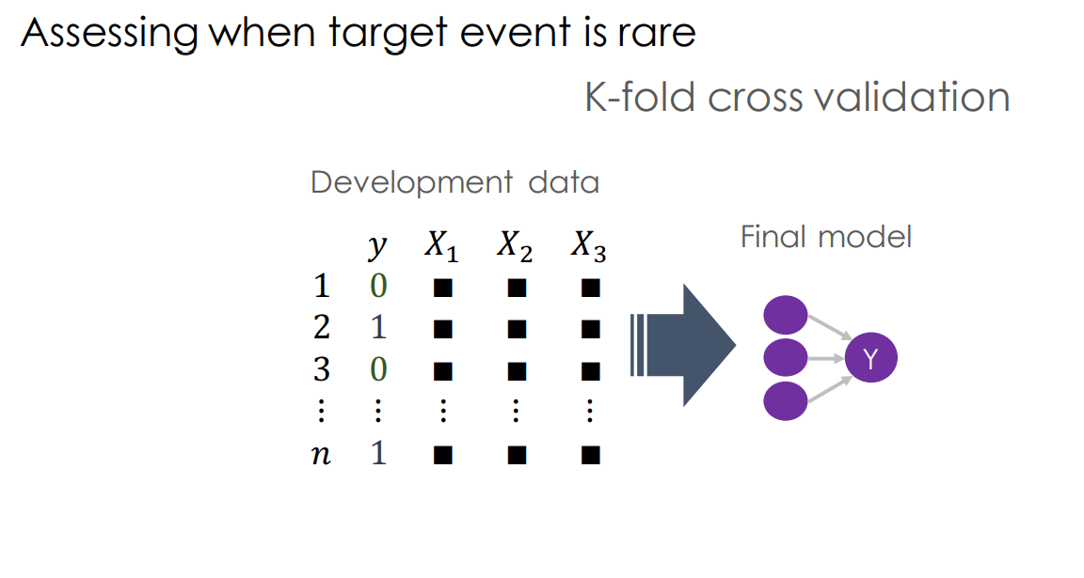
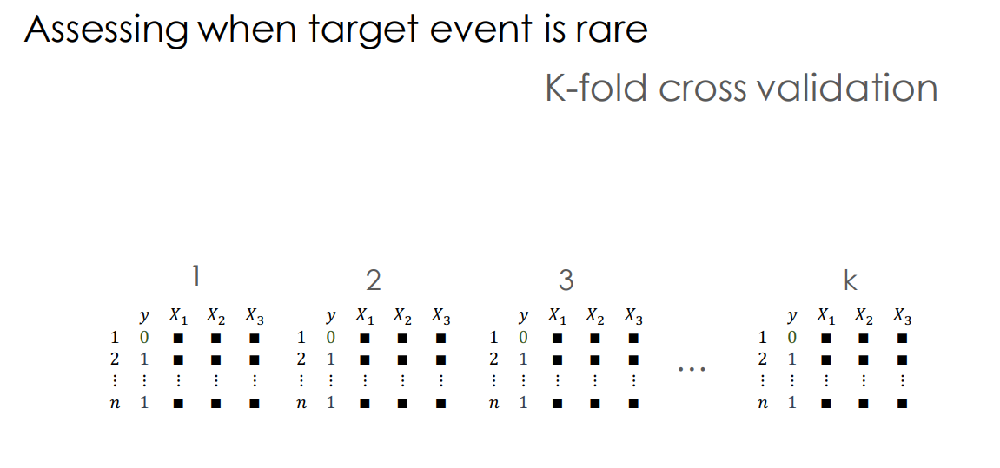
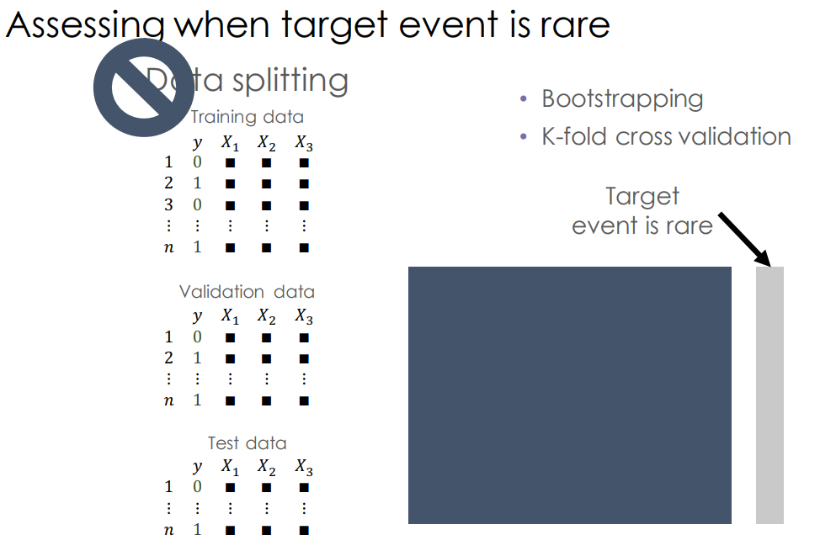
Model Selection
K-Fold

Slide 17
Model Selection
Grid Search

Slide 18
Next Session:
Clustering
Thanks! Let’s make the complex simple…

Slide 19
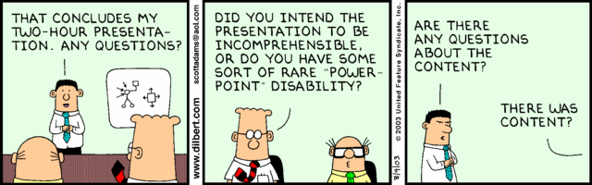
Enjoy Machine Learning
;)

